Slide 1
Self Driving Car
Anshu Pandey
TechTrunk Ventures Pvt Ltd

Slide 2
AI & Future
Enter the era of artificial intelligence (AI), an industry whose market value is expected to exceed $5 billion by 2020.
Actively used in web search systems and financial trading programs, predicting fraud and credit defaults, AI is expected to radically change the healthcare system, saving lives and healthcare costs.
Researchers anticipate that AI will impact all decisions in the future, from healthcare procedures and operations, to education, and economic policies.

Slide 3
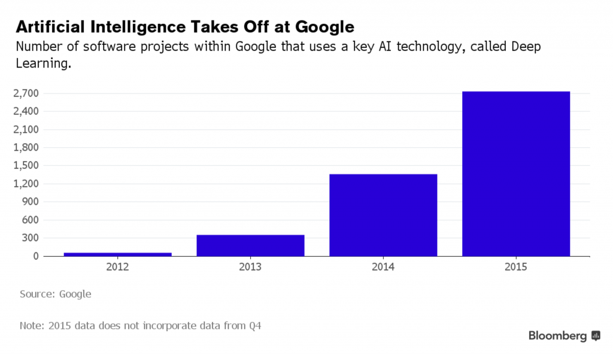

Slide 4
Expected Future Advancements

Slide 5
Every Company will be a user of AI
If your company isn’t using machine learning to detect anomalies, recommend products or predict churn, you will start doing it soon.
Every company will become a data company, utilizing machine learning to power their business at scale

Slide 6
Business bots will thrive
Internet bots, software that runs automated tasks, will move beyond simple chat applications like customer service and scheduling support, to impact business in more profound ways. As intelligent systems and automation further develop to serve the purpose of critical business functions, the business bot will coordinate services and launch businesses that we’ll experience in the near future.

Slide 7
Automatic Translation
While a simple concept, machine learning can also be used to instantly translate text into another language. Not only this, but it can do the same thing with text on images! In the case of text, the algorithm can learn about how words fit together and translate more accurately.
In the case of images, the neural network identifies letters in the image, pulls them into text, and then does the translation before putting them back into the picture.

Slide 8
Self Driving Cars
Driverless cars and/or intelligence added to cars that work in parallel with drivers.
Even Self Driving Car is going to replace drivers and bring a revolution in the automotive industry across the globe.

Slide 9
Travel & Communication:
By 2020, real-time translation technology may be fully accessible. We’ll see everything from an app on your phone that instantly translates foreign signs and texts to phone conversations that are immediately converted to a listener’s native language, without speakers even knowing the difference.

Slide 10
Convolution Networks (CNN) will Dominate
RNNs and LSTMs with its recurrent configuration and embedded memory nodes are going to be used less simply because they would not be competitive to a CNN based solution.

Slide 11
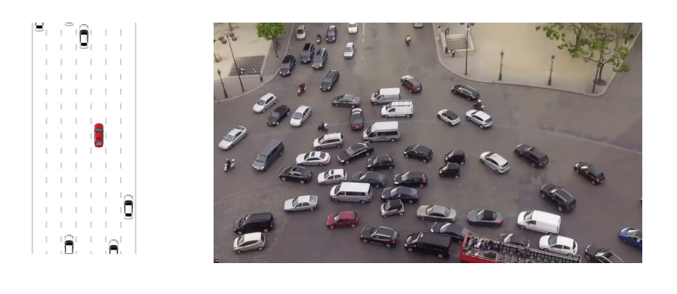
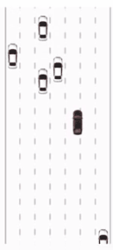
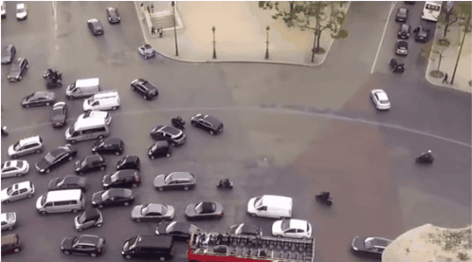
Self Driving Cars

Slide 12
Self Driving Cars Tasks
Localization & mapping
Scene Understanding, Environmental Analysis
Target Analysis
Movement Planning
Driver State

Slide 13
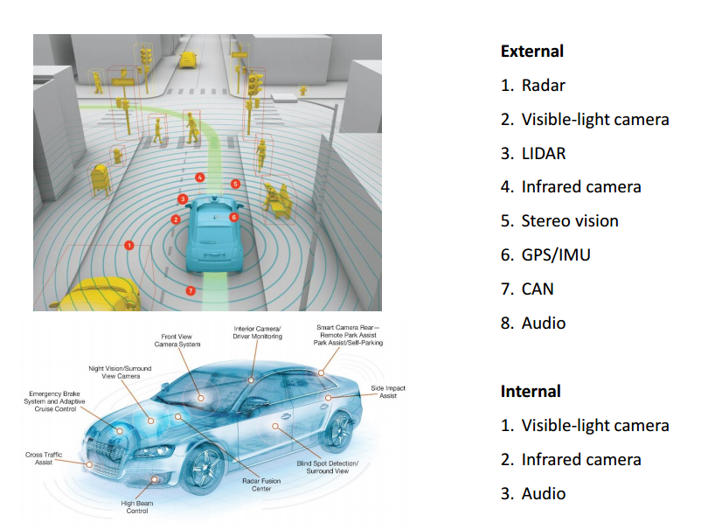

Slide 14
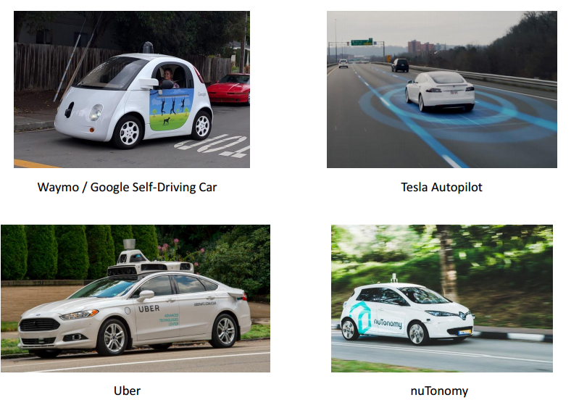
Companies working on SDC

Slide 15
We human learn to drive a car!
Therefore we will have to make our computer start learning – How to drive a car!

Slide 16
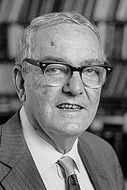
Machine Learning
Herbert Alexander Simon: “Learning is any process by which a system improves performance from experience.”
“Machine Learning is concerned with computer programs that automatically improve their performance through experience. “
Herbert Simon
Turing Award 1975 Nobel Prize in Economics 1978

Slide 17
Self Driving Cars

Slide 18
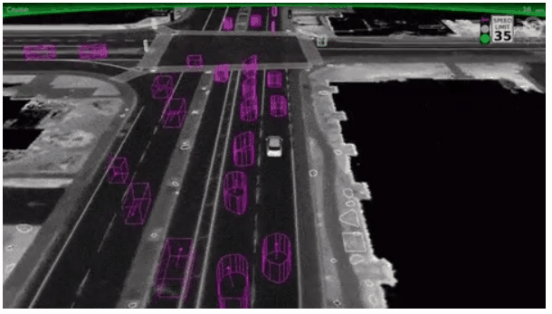
Deep Learning & Self Driving Cars

Slide 19
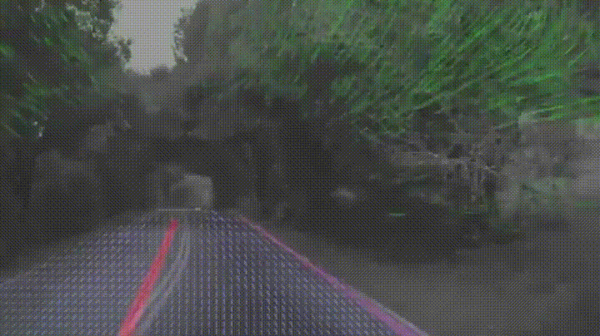
Self Driving Cars

Slide 20
Self Driving Car
Standard Robot
Create Data
Train a ANN Algorithm
ANN Driving the Robot
Test the Algorithm

Slide 21
In this work I have tried to design a self driving robot using camera data analysis.
Initially a manualy controlled machine is designed which can be controlled over Bluetooth from PC.
Interfacing it with Python, and using smartphone camera data is collected whenever the user takes the robot into different direction according to the environmental conditions and the python codes collects data in terms of images for every condition and names them as the direction taken by images.
In simple word, the user is driving a manual car and the python code is taking the snapshot of every condition for which user is taking decision and also saving those snapshot with the name of decisions so that we will have proper training data. E.g. If user is taking Robot forward, python code will save that snapshot with forward_01.jpg.

Slide 22
After Collection of Data, a Multilayer feedforward Neural Network is trained using the data, images are compressed upto 25x25 pixel to efficient training.
The Neural Network is also tested on some test data to check its efficiency, At this point more better work is to be done.
The Trained model is saved in local machine ( computer).
Again integrating the smartphone camera with python code, taking live images from the Robot using trained model we are making the model to predict the real time direction which Robot should Take and that the final work done till now.

Slide 23
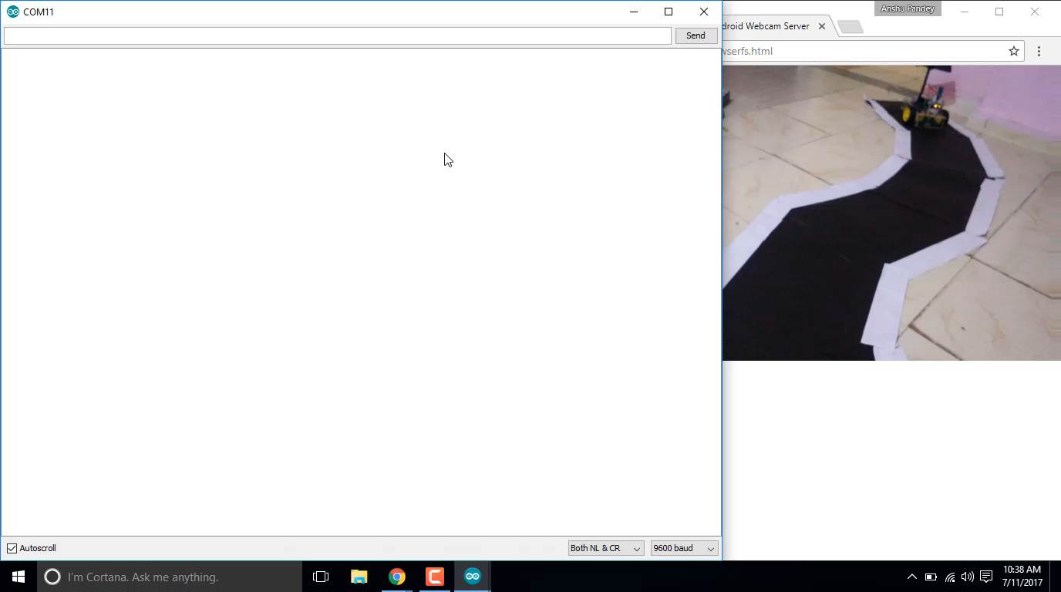
A Manual Robot controlled from Python

Slide 24
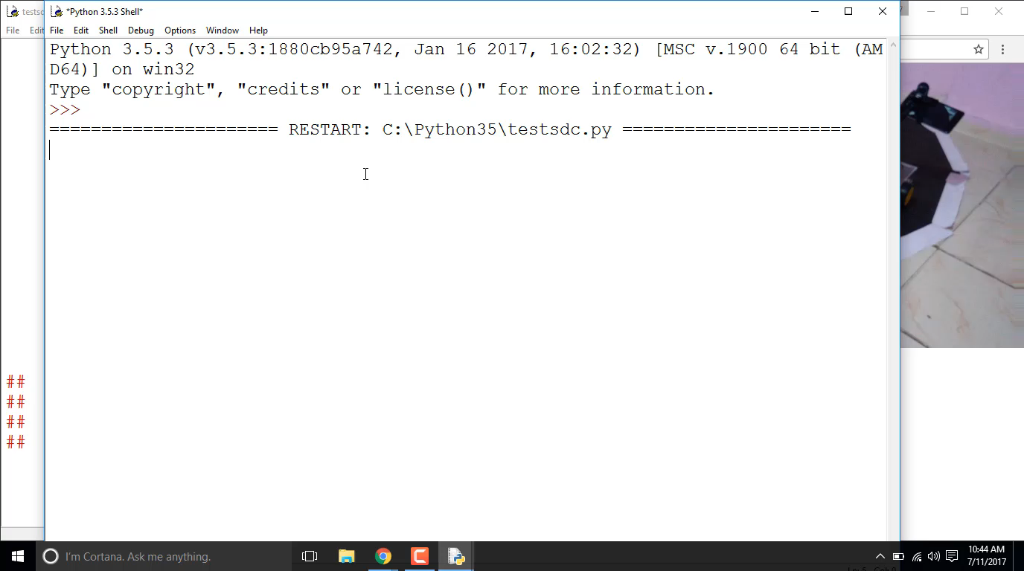
Collecting Data using Python

Slide 25
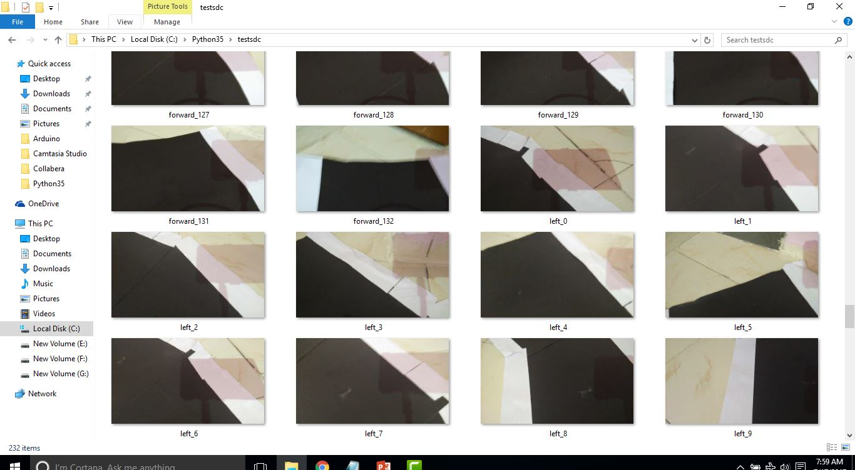
Collected Data

Slide 26
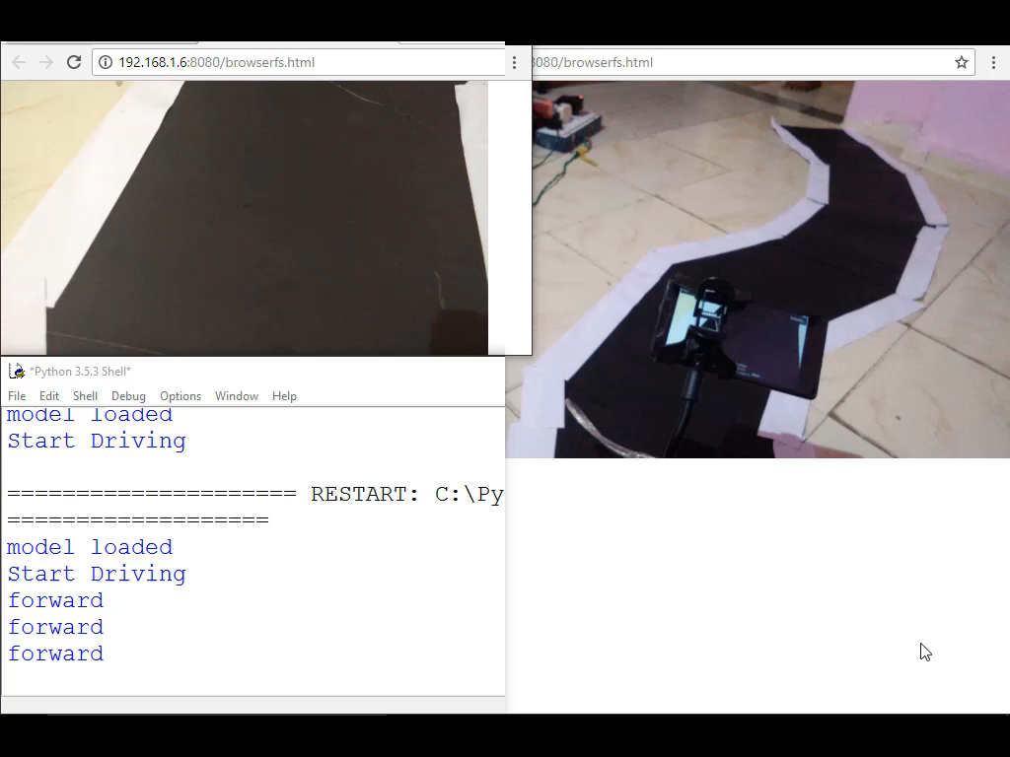
ANN Driving Robot After Training

